Slide 1


Sentimental Analysis and Gender Prediction on Social Media Post

Slide 2


Meet the Team
Sowjanya Linga
Team Leader & Data Analyst
Chandu Gogineni
Machine Learning Engineer
Hema Sai
Data Engineer
Lakshmi Prasanna
Data Engineer

Slide 3
Contents
Introduction​
Problems​
Solutions
Plan​
Tools used ​
Demo video
Github link and dataset​​
Conclusion​

Slide 4
Introduction
Our project, "Sentiment Analysis and Gender Prediction for Business Insights," is designed to provide businesses with a powerful toolkit for harnessing the potential of this data. By utilizing advanced natural language processing techniques, machine learning models, and intuitive visualizations, our solution offers a comprehensive approach to understanding user sentiments and demographics on social media.

Slide 5


Problems
1. The problem is to fulfill the increasing need for real-time public sentiment analysis about their products, services, or specific topics. It entails building a machine learning model to classify unstructured social media posts as positive, negative, or neutral sentiment, empowering informed decision-making.
In sentiment analysis, accurately determining the sentiment of a text can be challenging, especially when dealing with ambiguous statements or mixed sentiments which can arise from phrases that contain both positive and negative elements or sentiments that are context-dependent.
3

Slide 6


Solutions
1.Our solution involves creating a system that utilizes Natural Language Processing (NLP) techniques and machine learning models. This system will enable the analysis of sentiments in real-time, providing valuable insights into public opinions and emotions expressed in social media posts and text data.
2. Enhancing sentiment analysis by analyzing statement context through dependency parsing. This involves considering words around sentiment-bearing words for a better grasp of overall meaning. Employing machine learning, including deep learning models, to refine sentiment analysis by incorporating contextual insights. Additionally, implementing rules for handling specific cases like negations. Introducing a user feedback mechanism to continuously improve the model based on user input.
3

Slide 8


Tools Used
Python: The primary programming language for building the sentiment analysis model.
Scikit-Learn: For training and deploying machine learning models.
Natural Language Toolkit (NLTK) or spaCy: For text processing, tokenization, and feature extraction.
Word Embeddings (Word2Vec, GloVe): Pre-trained word vectors to enhance model accuracy.
Machine Learning Libraries: Libraries for building and training sentiment analysis models, such as TensorFlow, PyTorch, or scikit-learn.
Jupyter Notebook: An interactive development environment for data analysis and machine learning.

Slide 9
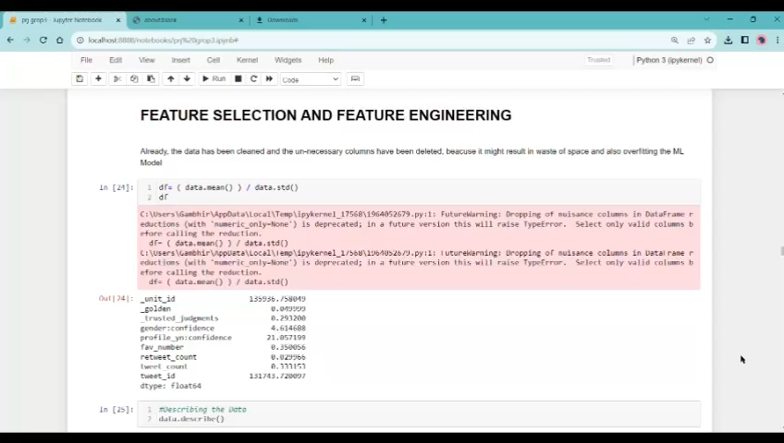
Demo Video

Slide 10
Github link and dataset​
https://www.kaggle.com/code/paoloripamonti/twitter-sentiment-analysis/input
https://github.com/DSCI6007-Group3/Group3/blob/main/result.html

Slide 11

THANK YOU

